Slide 1
Solving the Maze problem with ILP
Angelo Andreussi, Alex Della Schiava, Claudia Maußner

Slide 2
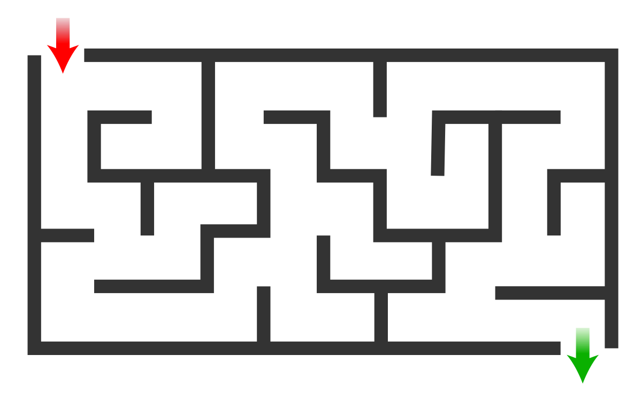
The Maze Problem
A fairly simple problem.
Find a path from point A to point B in a labyrinth-shaped map.
Can be solved with a huge variety of classical algorithms
An example of a Maze

Slide 3
Our tools
HYPER (Bratko, 1999): Based on Top-down search in the hypothesis space (Best-first search).
Metagol (Cropper, Muggleton, 2016): Based on meta-interpretative learning.
ILASP (Law, 2018): Inductive Logic Programming in the context of Answer Set Programs (ASP).

Slide 4
Our goals
Of course, solving the Maze problem.
In some cases, directly through ILP;
Otherwise, using the code learned through ILP.
Comparing HYPER, Metagol and ILASP.
Different systems produce different performances.
Not only, they can also lead to huge differences in the approach of the problem.
Further studying and analyzing these ILP techniques.

Slide 5
The maze
All three implementations use the same maze:
 |  | X=1 | X=2 | X=3 | X=4 | X=5
Y=1 |  | S
Y=2
Y=3
Y=4
Y=5 |  |  | G

Slide 6
Hyper

Slide 7

Brief recap
Key components:
Background knowledge.
Replacing structured terms.
Start hypotheses.
Positive examples.
Negative examples.
Learning procedure:
Choose complete start hypotheses.
Refine the hypotheses by
Matching two variables of the same type
Adding a goal from background knowledge
Refining a variable to background terms

Slide 8
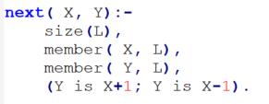
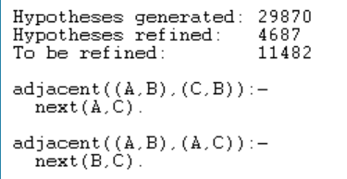
Learning adjacent cells
Goal: Learn adjacent cells, not considering obstacles. (Predicate adjacent/2).
Background Knowledge:
backliteral( next( X, Y), [X:integer], [Y:integer]).
Structured terms:
term( cell, (A, B), [A:integer, B:integer]).
Start Hypothesis:
start_clause( [adjacent( X, Y)] / [ X:cell, Y:cell] ).
Positive examples: 4 /Negative examples: 3
Parameters:
max_proof_length( 2).
max_clauses( 2).
max_clause_length( 3).

Slide 9
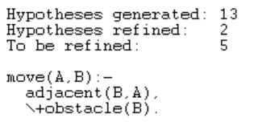
Learning to walk
Goal: Learn to move to an adjacent, legal cell (cell with no obstacle). (Predicate move/2).
Background Knowledge:
backliteral( obstacle(X), [X:cell], []).
backliteral( \+ (G), [X:cell], []) :-
G = obstacle(X).
backliteral( adjacent(X,Y), [X:cell,Y:cell], []).
Structured terms: none
Start Hypothesis: start_clause( [move(X,Y)] / [ X:cell, Y:cell] ).
Positive examples: 1 / Negative examples: 1
Parameters:
max_proof_length( 2).
max_clauses( 2).
max_clause_length( 3).
The number of hypotheses generated and refined is independent of the size of the grid and the grid!

Slide 10
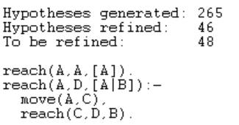
Learning to travel
Goal: Learn to move from two distant cells in the maze without going through illegal cells. (Predicate reach/3).
Background Knowledge:
backliteral( move(X,Y), [X:cell], [Y:cell]).
backliteral( reach(X,Y,L), [X:cell,L:list], [Y:cell]).
Structured terms:
term( list1, [X|L], [ X:cell, L:list]).
term( list1, [X], [X:cell]).
Start hypothesis: start_clause([ reach(X,Y,L)] / [X:cell,Y:cell,L:list1]).
Positive examples: 3 / Negative examples: 5
Parameters:
max_proof_length( 5).
max_clauses( 2).
max_clause_length( 3).

Slide 11
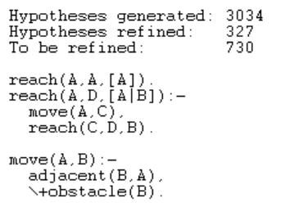
Combined Learning: walk & travel
Goal: Learn the two predicates move/2 and reach/3 at once.
Background Knowledge:
Same as before for both tasks
Structured terms:
Same as before for both tasks
Start hypothesis: Same as before for both tasks
start_clause( [move(X,Y)] / [ X:cell, Y:cell] ).
start_clause( [ reach(X,Y,L)] / [X:cell,Y:cell,L:list1] ).
Positive examples / Negative examples: same as before
Parameters: Changed!
max_proof_length( 7).
max_clauses( 4).
max_clause_length( 3).

Slide 12
Performance comparison Hyper
Task | Time (*) | # Hypotheses generated | # Hypotheses refined
adjacent | 175,884 s | 29,870 | 4,687
Move (**) | 0,063 s | 13 | 2
reach | 1,577 s | 265 | 46
move & reach | 16,585 s | 3034 | 327
(*) Mean values from 10 runs
(**) Independent of grid

Slide 13
Findings
Do not put too many examples! Start with 1- 2 examples and then add successively new ones as needed.
Do not forget about the parameter settings.
Start learning small steps / simple tasks.
It is more efficient to learn each action on its own then all at once (only one start_clause). With more than one start clause and many backliterals the task grows heavily.
Recursiveness simplifies the learning.

